Slide 1


Slide 2
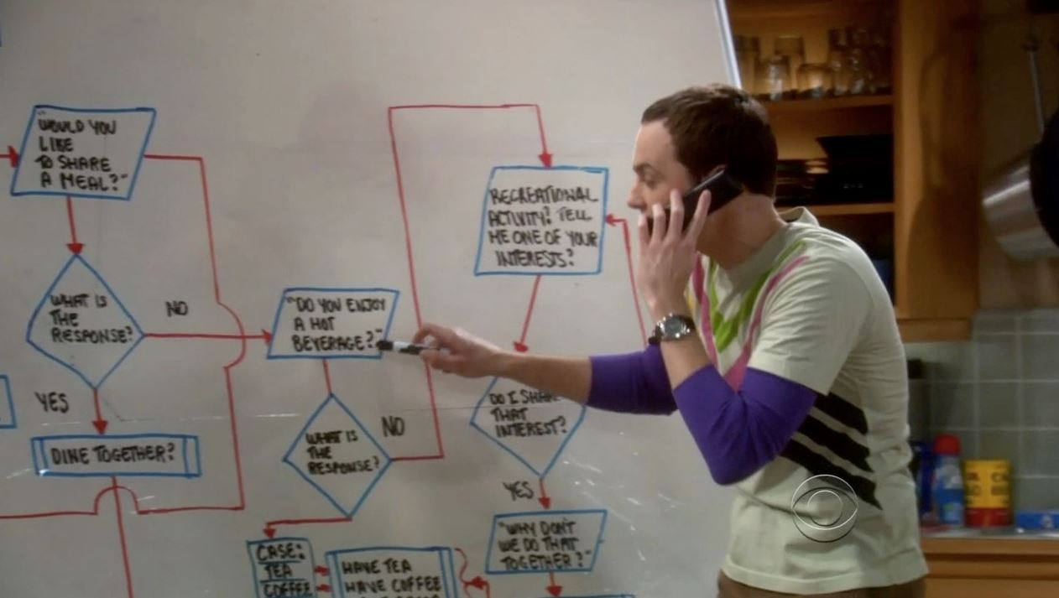
FIT1045 Introduction to Algorithms and Programming Lecture 3 Selection
COMMONWEALTH OF AUSTRALIA
Copyright Regulations 1969
WARNING
This material has been reproduced and communicated to you by or on behalf of Monash University pursuant to Part VB of the Copyright Act 1968 (the Act).The material in this communication may be subject to copyright under the Act.Any further reproduction or communication of this material by you may be the subject of copyright protection under the Act.
Do not remove this notice.

Slide 3
Objectives
Introduce how to compare integers, floats, and strings.
Introduce Boolean expressions.
Introduce how to implement selection in Python.

Slide 4
Overview
Comparison operators
Boolean expressions
One way selection
Two way selections
Multiple selections

Slide 5
Integer Comparison Operators
Operation | Description
< | Less than
<= | Less than or equal
> | Greater than
>= | Greater than or equal
== | Equal
!= | Not equal
>>> 10 < 3
False
>>> 10 == 3
False
>>> 10 >= 3
True
>>> 10 != 3
True
Need two

Slide 6
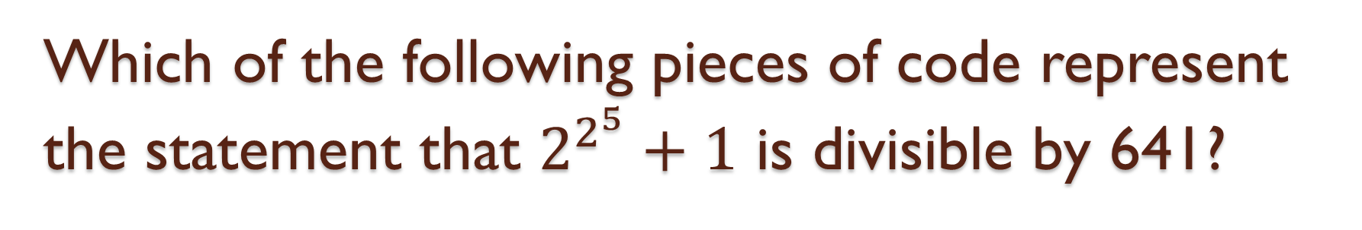
Which of the following pieces of code represent the statement that $2^{2^{5}}+1$ is divisible by 641?
2**2**5 + 1 % 641 = 0
(2**2)**5 + 1 / 641 == 0
(2**2**5 + 1) % 641 == 0
2**(2**5) + 1 // 641 = 0
Using MARS
Visit http://mars.mu on your internet enabled device
Log in using your Authcate details (not required if you’re already logged in to Monash)
Touch the + symbol
Enter the code for your unit: ZIETFF
1

Slide 7
Floating numbers comparisons
Operation | Description
< | Less than
<= | Less than or equal
> | Greater than
>= | Greater than or equal
== | Equal
!= | Not equal
>>> 0.999999999999999 == 1
False
>>> 0.99999999999999999 == 1
True
Do not use with floating point numbers
A better approach:
0.0000000001
>>> abs(0.999999999999999 – 1) < 1.0e-10
True

Slide 8
Strings
>>> s = “HELLO”
H
E
L
L
O
s
index
0
1
2
3
4
Negative index
-5
-4
-3
-2
-1
>>> s[0]
‘H’
>>> s[4]
‘O’
>>> s[2 : 4]
’LL’
>>> s[-2 : ]
‘LO’

Slide 9
String operations
Operation | Description
< | Less than
<= | Less than or equal
> | Greater than
>= | Greater than or equal
== | Equal
!= | Not equal
x in s | True if x is a substring of s
x not in s | True if x is not a substring of s
>>> s = “HELLO”
>>> s == “Hello”
False
>>> s < “World”
True
>>> s < “hello”
True
>>> ‘ELL’ in s
True

Slide 10
Which of the following statements checks whether the start of a string, address, is the substring ‘http’
address[0:4] == ‘http’
address[0:4] = ‘http’
address[1:5] == ‘http’
address[0:5] == ‘http’
1

Slide 11
Boolean Expressions
Expressions that have values True or False.
Can combine expressions with the following operations.
Operation
not
and
or
>>> x = 10
>>> 1 <= x and x <= 100
True
>>> 1 <= x or x <= 9
True

Slide 12
Every year that is exactly divisible by four is a leap year, except for years that are exactly divisible by 100, but these centurial years are leap years if they are exactly divisible by 400. Which of the following statements are true?
All of 2000, 1900, 2016 are leap years
All of 2100, 1900, 2015 are not leap years
All of 2100, 2000, 2015 are not leap years
All of 2000, 1900, 2016 are not leap years

Slide 13
Fact.
Excel incorrectly assumes that 1900 is a leap year.

Slide 14
Which of the following Boolean expressions true if and only if the value of year is a leap year.
year % 4 == 0 and (year % 100 != 0 or year % 400 == 0)
year % 4 == 0 or (year % 100 != 0 and year % 400 == 0)
(year % 4 == 0 or year % 400 == 0) and year % 100 != 0
(year % 4 == 0 and year % 400 == 0) or year % 100 != 0
1

Slide 15
Logic of an if statement
Boolean
expression
true
false
block

Slide 16
if statement
Must end expression with :
if boolean_expression:
block
Boolean
expression
true
false
block
Must indent code (at least 4 spaces)

Slide 17
isEven.py
n = int(input(“Enter integer: ”))
response = “ is odd”
if n % 2 == 0:
response = “ is even”
print(str(n) + response)

Slide 18
isLeapYear.py
year = int(input(“Enter year: ”))
response = “ is not a leap year”
if year % 4 == 0 and (year % 100 != 0 or year % 400 == 0) :
response = “ is a leap year”
print(str(year) + response)

Slide 19
Logic of an if-else statement
Boolean
expression
true
false
block1
block2

Slide 20
if-else statement
Must indent code (at least 4 spaces)
if boolean_expression:
block1
else:
block2
Boolean
expression
true
false
Must end with :
block1
block2

Slide 21
isLeapYear2.py
year = int(input(“Enter year: ”))
if year % 4 == 0 and (year % 100 != 0 or year % 400 == 0) :
response = “ is a leap year”
print(str(year) + response)
year = int(input(“Enter year: ”))
if year % 4 == 0 and (year % 100 != 0 or year % 400 == 0) :
response = str(year) + “ is a leap year”
else:
response = str(year) + “ is not a leap year”
print(response)

Slide 22
Multiple selection
if boolean_expression1:
block1
elif boolean_expression2:
block2
elif boolean_expression3:
block3
elif boolean_expression4:
block4
else:
last_block

Slide 23
daysInMonth.py
This is a comment
month = input(“Enter month: ”)
’Convert the first 3 characters of month to lower case’
month = month[:3].lower()
if month == ‘feb’ :
print(‘29 days for leap year and 28 days for non leap year’)
elif month == ‘sep’ or month == ‘apr’ or month == ‘jun’ or month == ‘nov’:
print(‘30 days’)
else:
print(‘31 days’)

Slide 24
Nested if statements
If statements within if statements
month = input(‘Enter month: ‘)
'Convert the first 3 characters of month to lower case'
month = month[:3].lower()
if month == 'feb' :
year = int(input("Enter year: "))
if year % 4 == 0 and (year % 100 != 0 or year % 400 == 0) :
print('29 days')
else:
print('28 days')
elif month == 'sep' or month == 'apr' or month == 'jun' or month == 'nov':
print('30 days')
else:
print('31 days')

Slide 25
Recommended reading
“Introduction to Computing using Python: An Application Development Focus”, by L. Perkovic
Sections 5.2 – 5.6

Slide 26
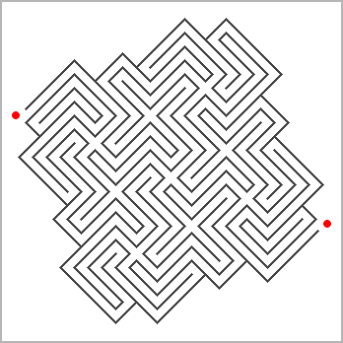
Creating Mazes
Develop a procedure for creating mazes.
Nine crossroads © Andrea Gilbert (www.clickmazes.com)

Slide 27
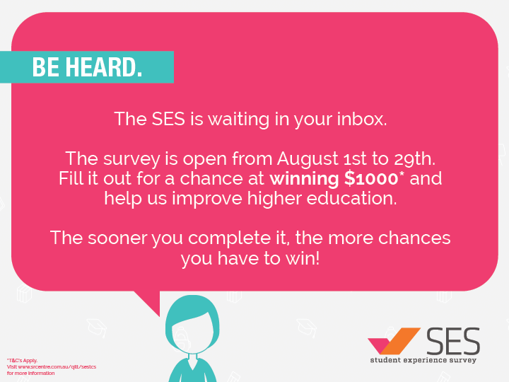
Nine crossroads © Andrea Gilbert (www.clickmazes.com)

